Slide 1
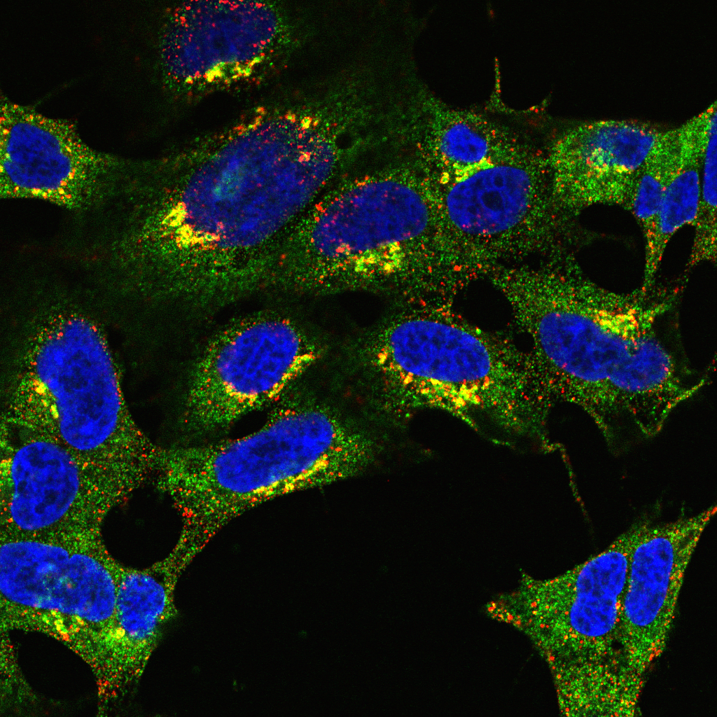
Introduction to colocalisation analysis Part 2

Slide 2
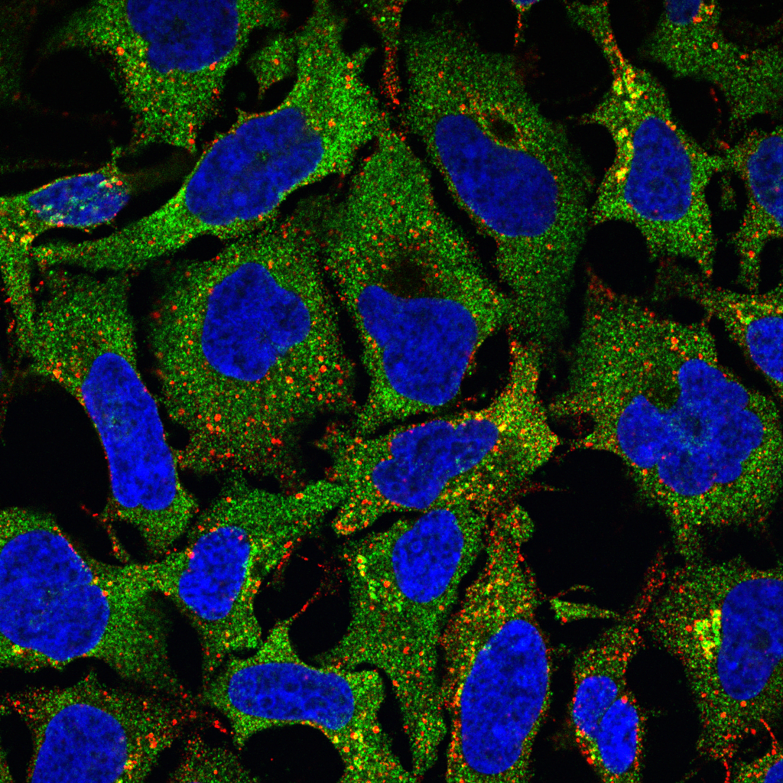
What do we mean by colocalisation?

Slide 3
What do we mean by colocalisation?
Typically refers to one of two things:
Biologists’ Definition: Co-occurrence of two or more proteins
Statisticians’ Definition: Correlation of two fluorescent signals
A
B

Slide 4
Biologists’ assessment often visual
Simplest Case:
Merge two fluorescence pseudo-coloured images
Assess whether different wavelengths are present in same pixels
E.g. Red + Green = Yellow
Problem:
Intermediate colour (e.g. yellow) only visible if probes overlap in similar proportions

Slide 5

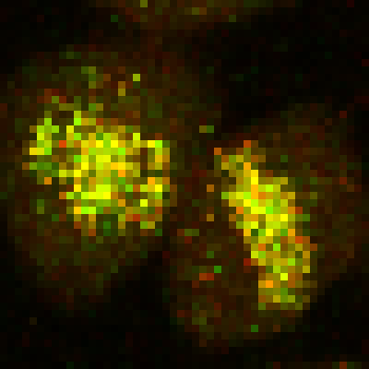
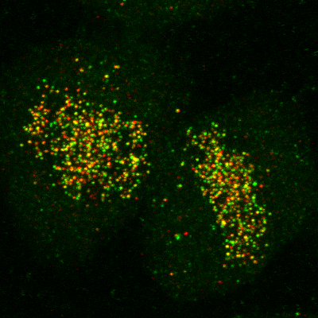
Correlation is not causation
Colocalisation does not imply interaction
Non-colocalisation probably implies no interaction
Dividing line between colocalisation and non-colocalisation is arbitrary
Extent of colocalisation decreases with increasing spatial resolution
Demmerle et al., Nat Protocols, 2017
Relative Localisation
Correlation Analysis

Slide 6
What is Quantitative Colocalisation?
“Under the conditions of proportional co-distribution, points of the scatterplot cluster around a straight line, whose slope reflects the ratio of the fluorescence of the two probes.”
Dunn et al., Am J Physiol Cell Physiol, 2011

Slide 7
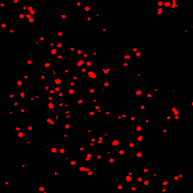
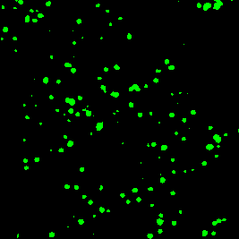
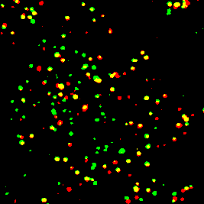
Intensity-based correlation coefficients
Pearsons
Analysis of signal correlation
Spearmans
Similar to Pearsons
Less sensitive to outliers
Manders
Analysis of signal overlap

Slide 8
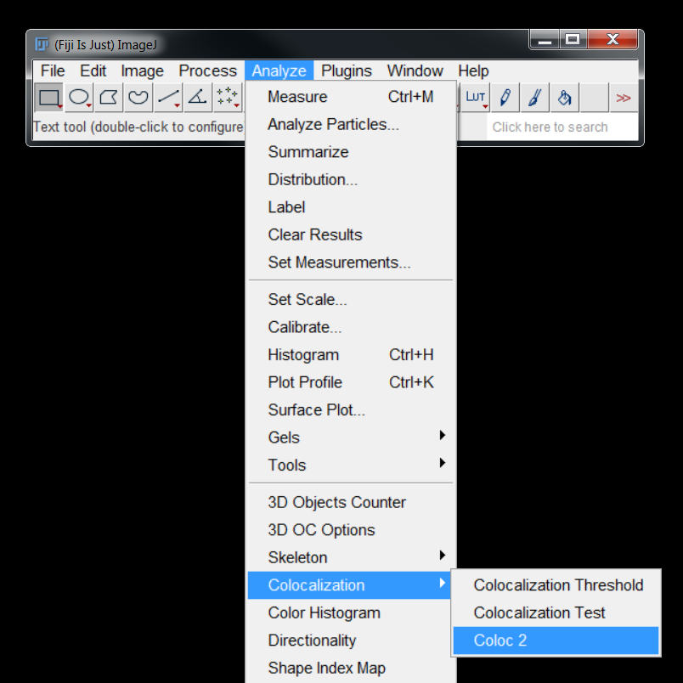
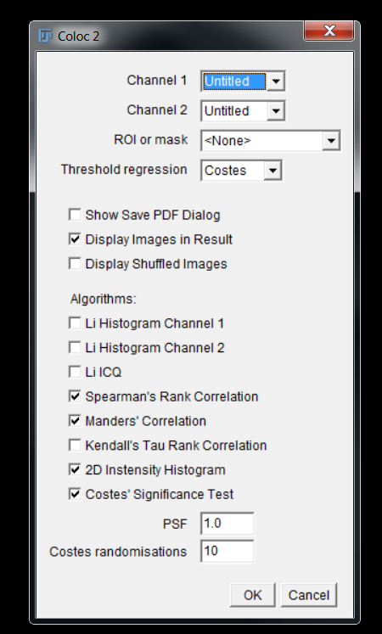
COLOC2 – FIJI Plugin for colocalisation analysis

Slide 9
Background causes spurious results
Quantification of P_{CC} within cells indicates poor association (P_{CC} = 0.16)
When quantified over entire image, P_{CC} = 0.39
Dunn et al., Am J Physiol Cell Physiol, 2011

Slide 10
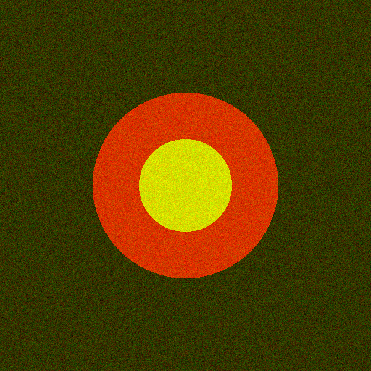
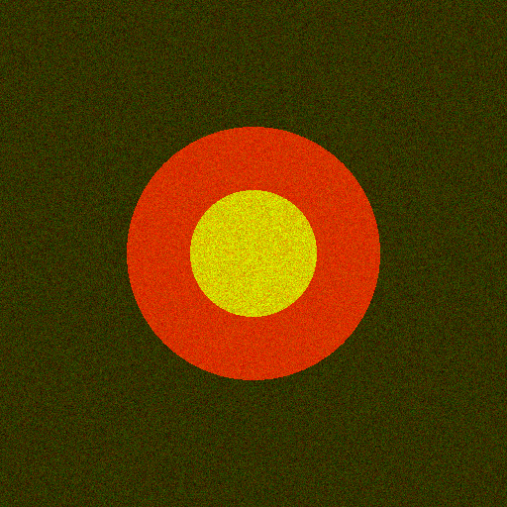
Noise results in “Less” correlation
P_{cc} = 0.41
P_{cc} = 0.33
Sample can exhibit high co-occurrence, but low correlation

Slide 11
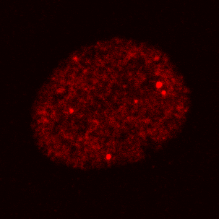
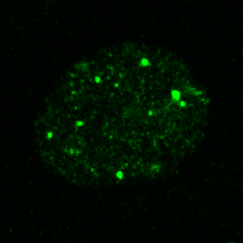
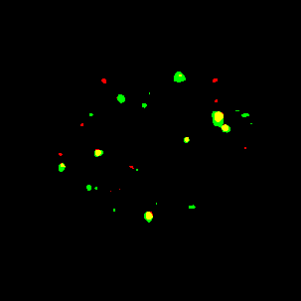
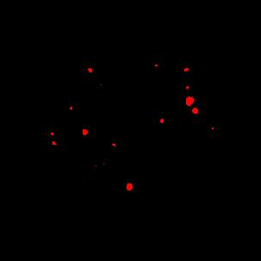
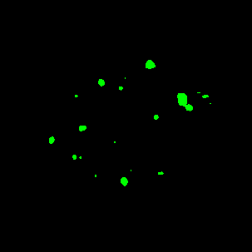
M_{red-green} = 0.59
M_{green-red} = 0.68

Slide 12
Dunn et al., Am J Physiol Cell Physiol, 2011

Slide 14
Common sources of error

Slide 15
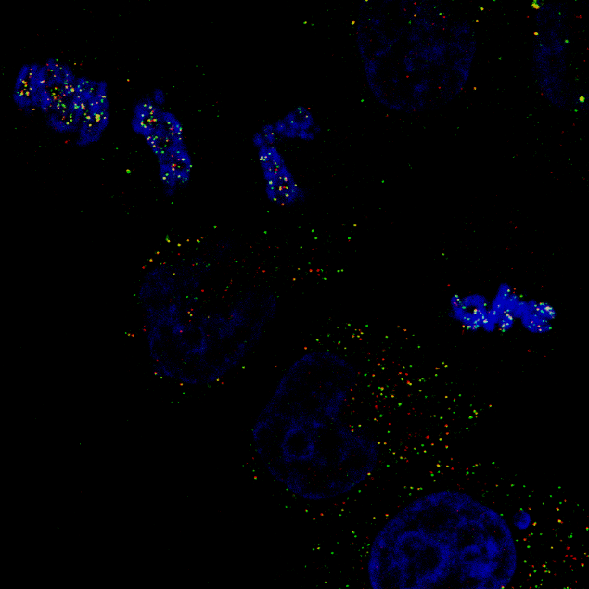
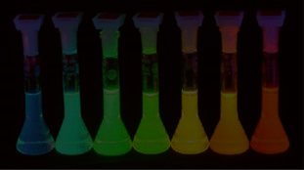
Potential pitfalls
Probes:
Signal is sufficient to distinguish from noise and background
Uncontaminated by auto-fluorescence
Free of signal bleed-through
Image:
No lossy compression
Not saturated / clipped / overexposed
Spatial resolution sufficiently high

Slide 16
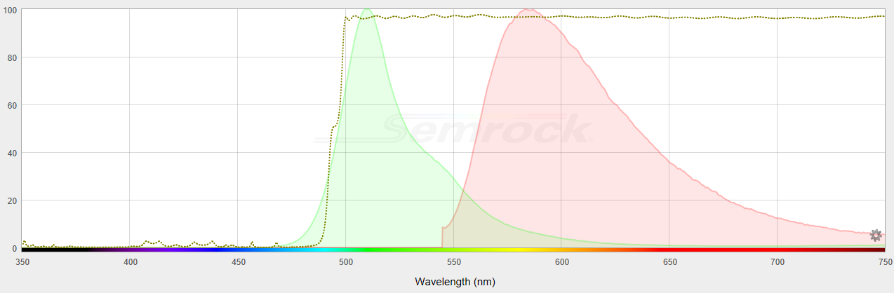
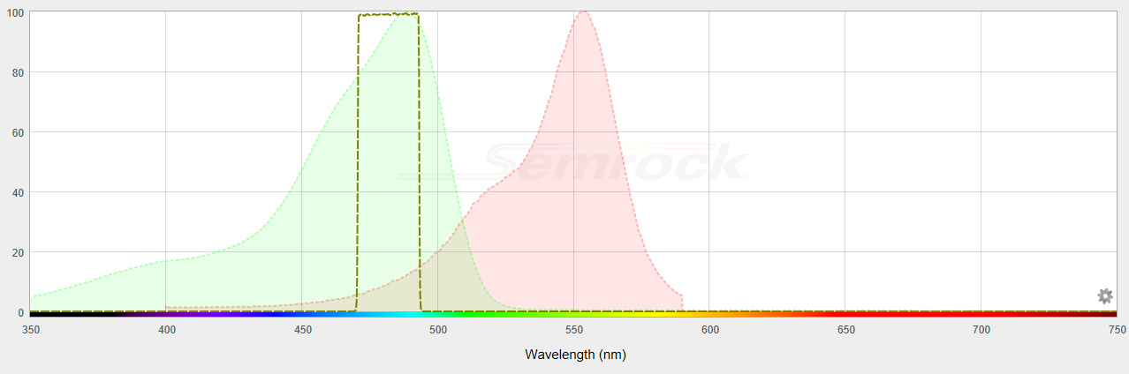
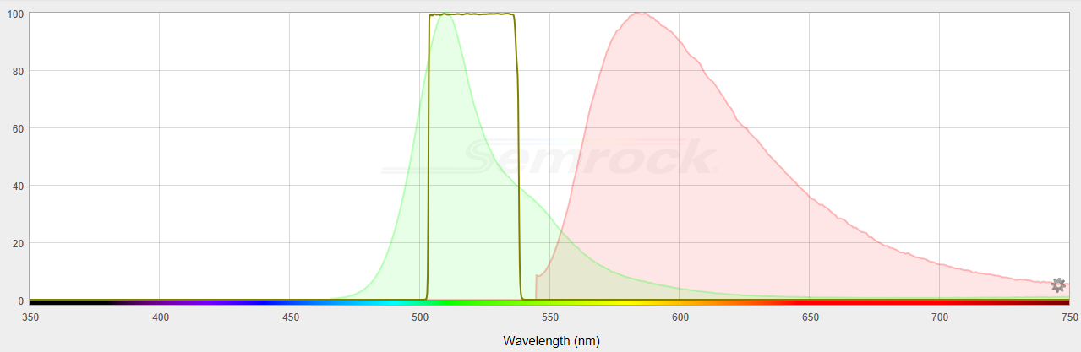
Avoiding bleed-through
Maximizing excitation and emission collection should be balanced with minimizing bleed-through
Emission
Filter
Excitation
Filter
GFP
GFP
RFP
RFP
https://searchlight.idex-hs.com/

Slide 17
Chromatic aberration
Waters, JCB, 2009

Slide 18
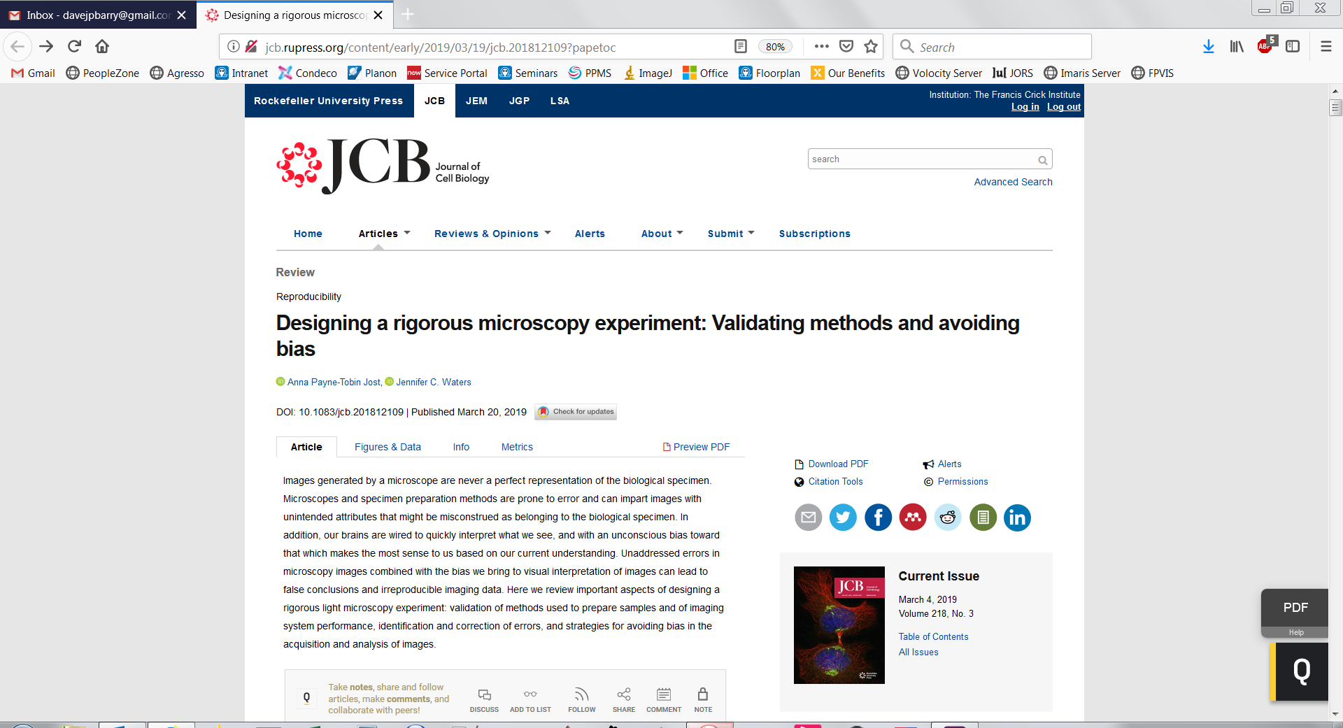
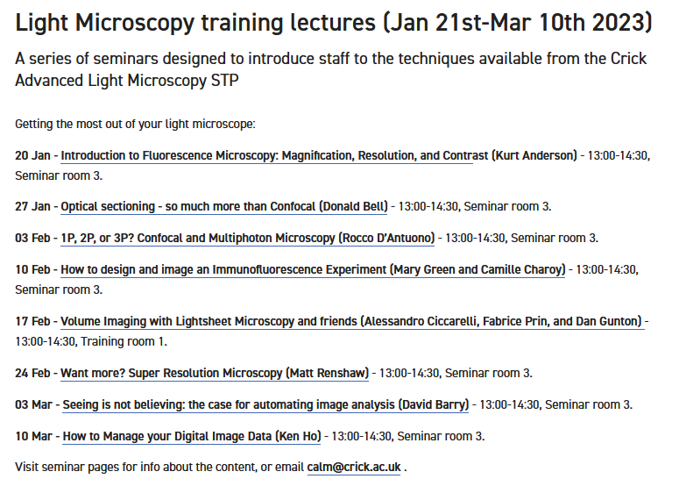
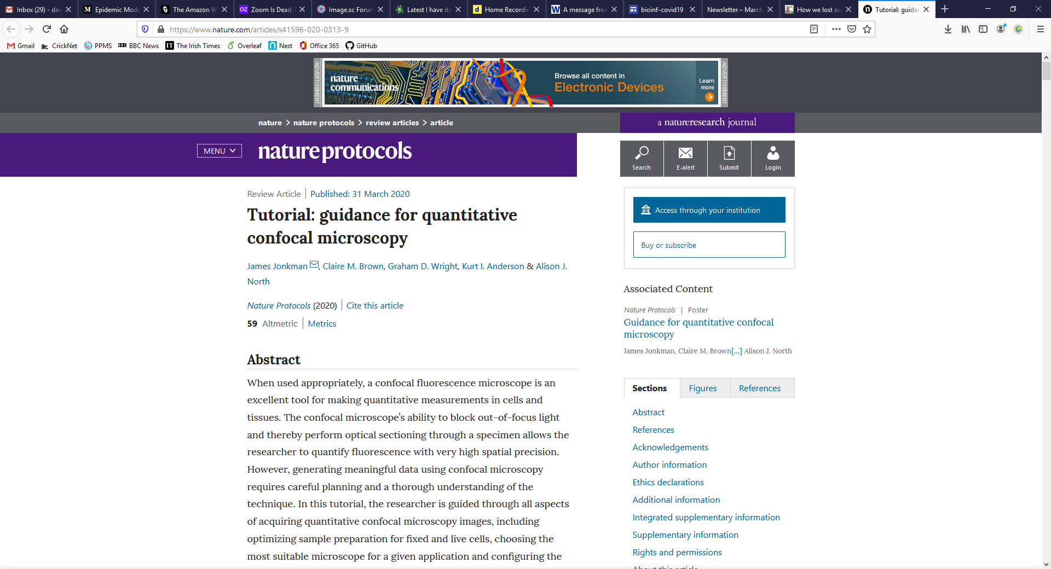

Slide 19
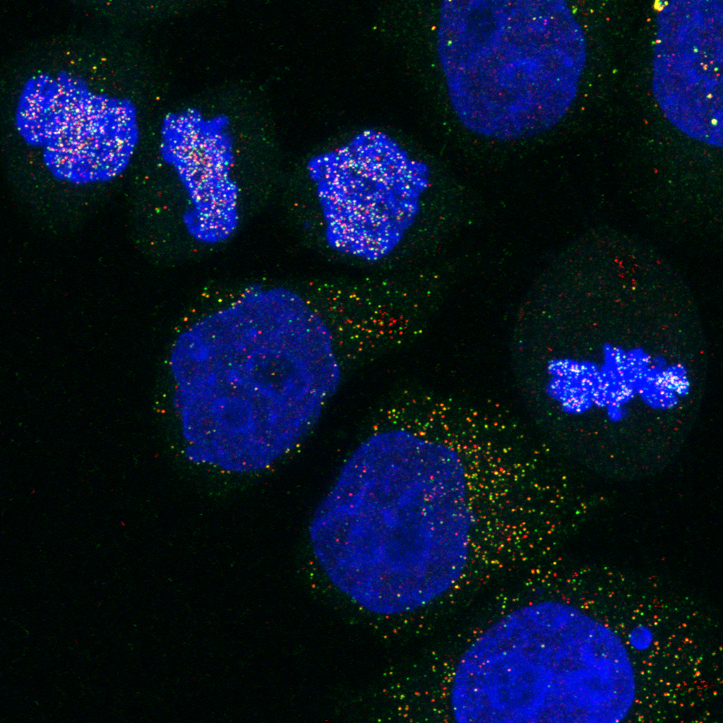
Calculating Thresholds

Slide 20
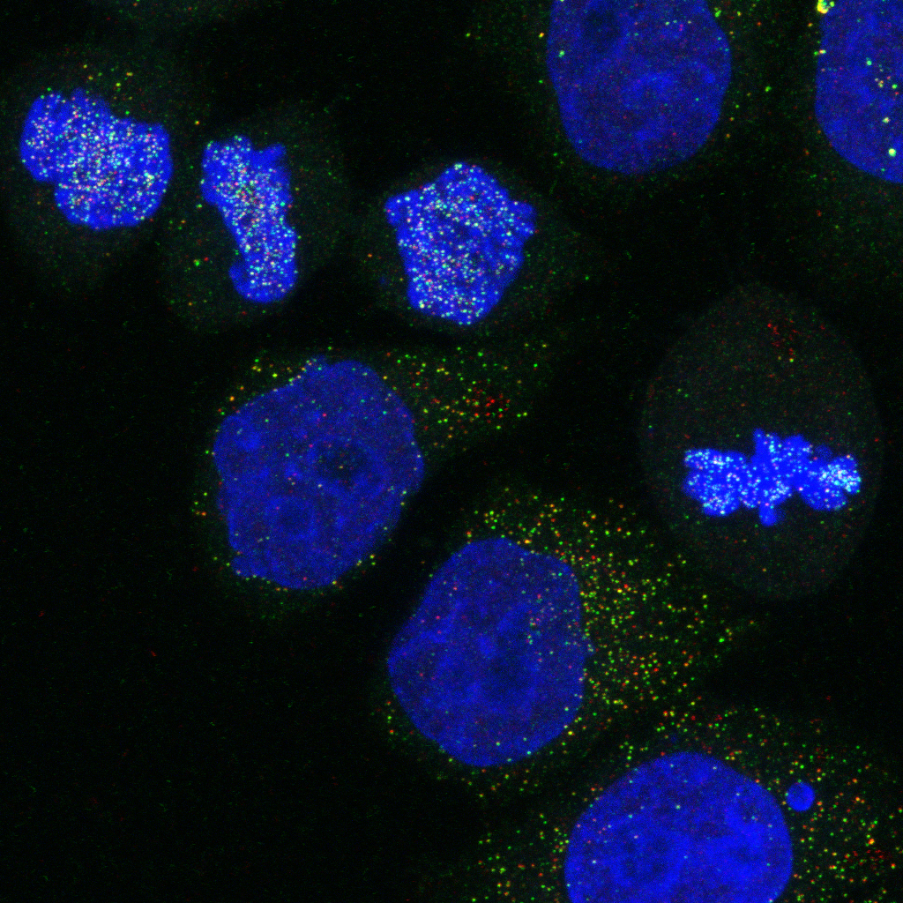
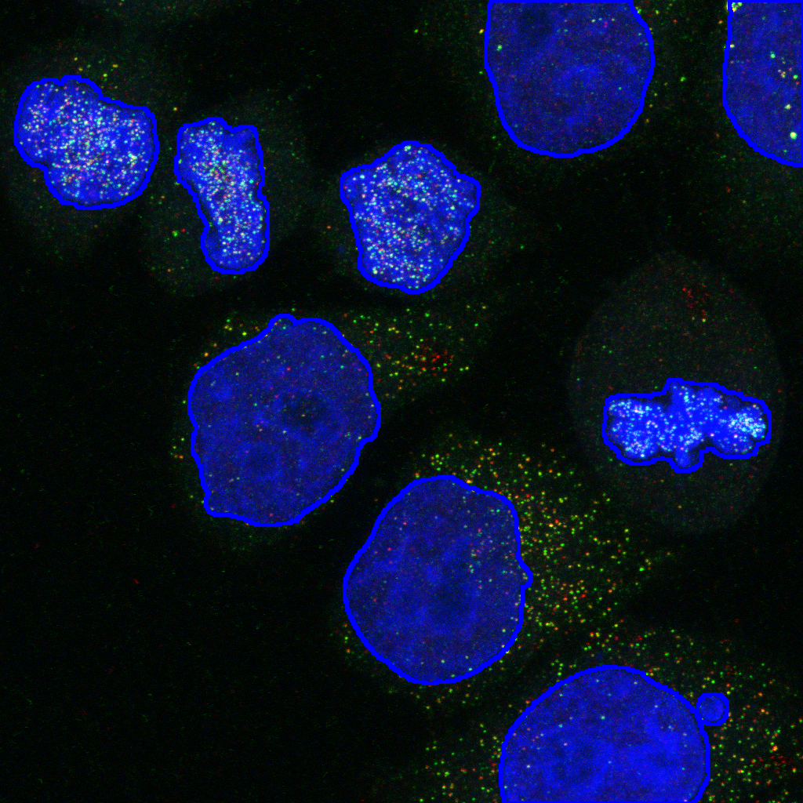
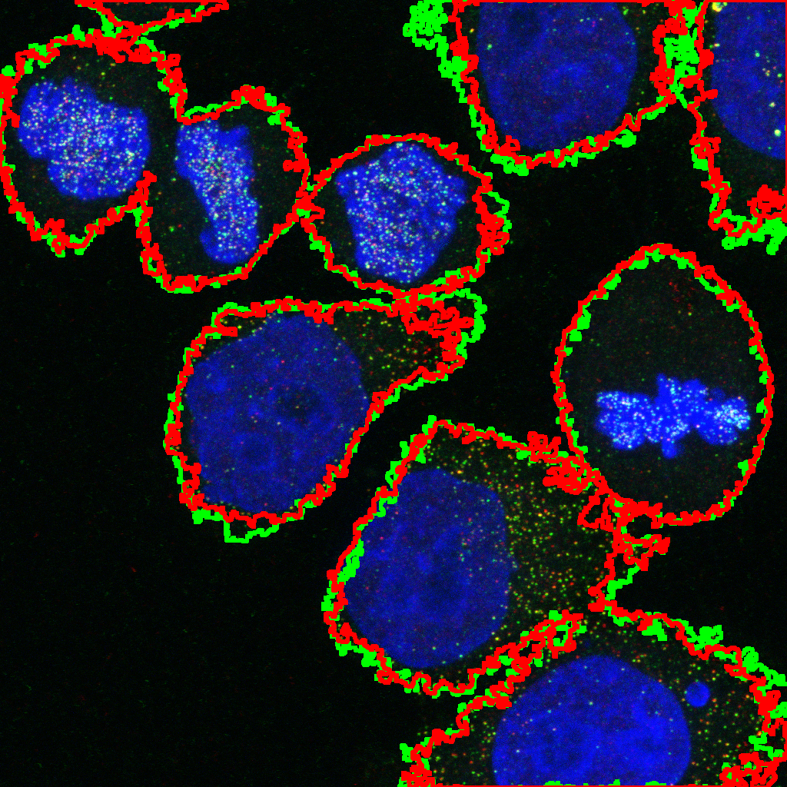
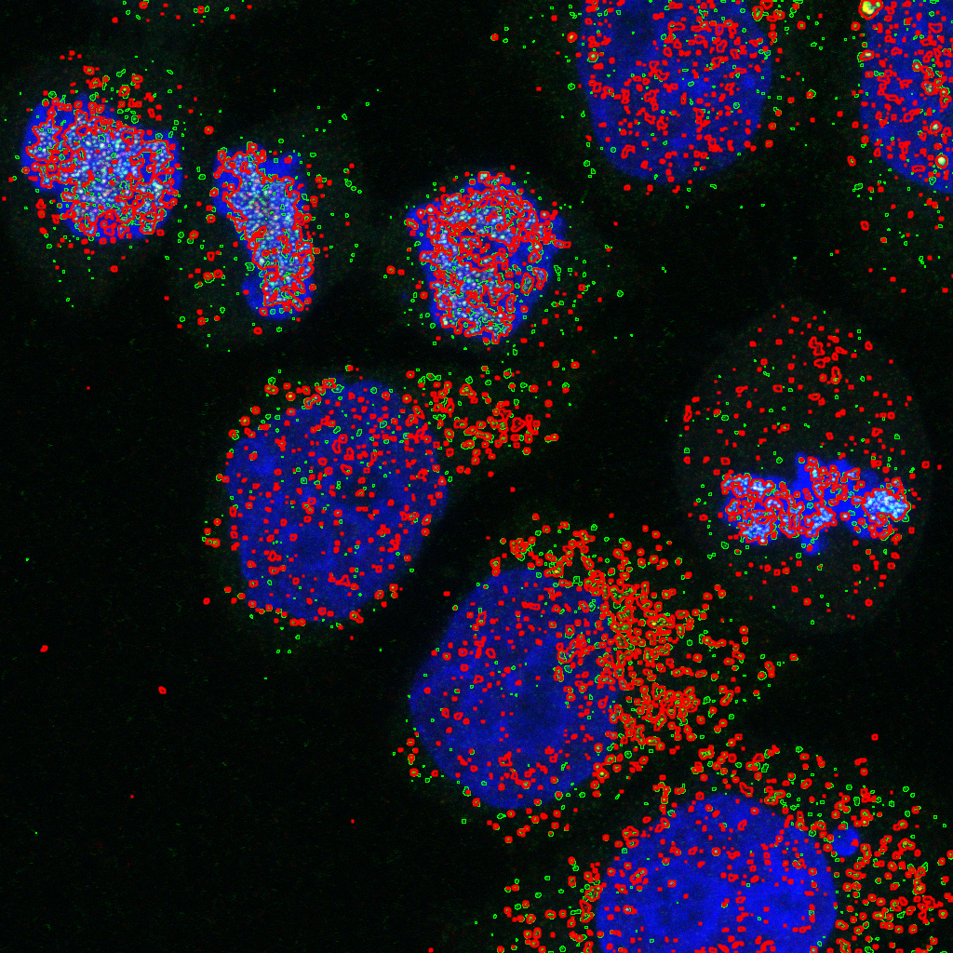

Slide 21
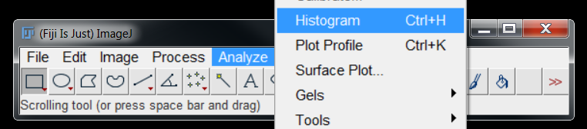
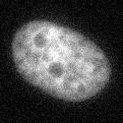
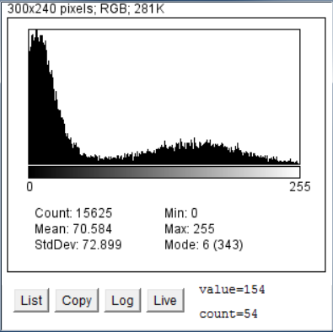
Quick Refresher on Segmentation
“Foreground”
“Background”
Can be exploited for segmentation

Slide 22

What is image segmentation?
Background labelled white (255)
Background
Foreground labelled black (0)
Foreground
Process of dividing image into regions
Assigning labels to each pixel
“Binary” or “Mask” Image

Slide 23
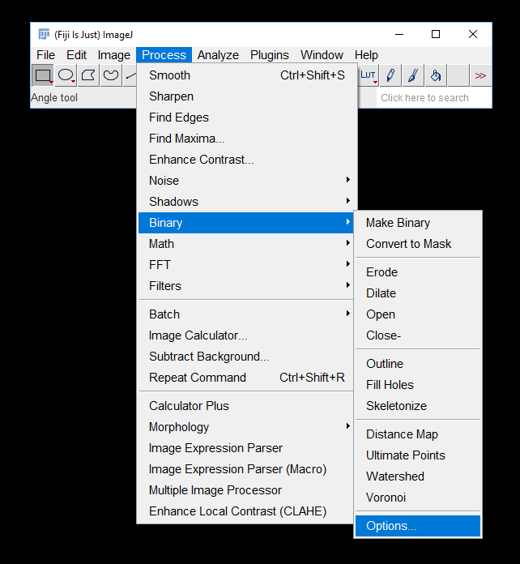
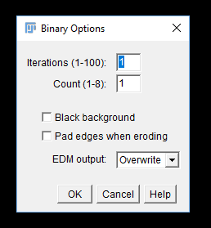
Masks can be black on white or white on black

Slide 24
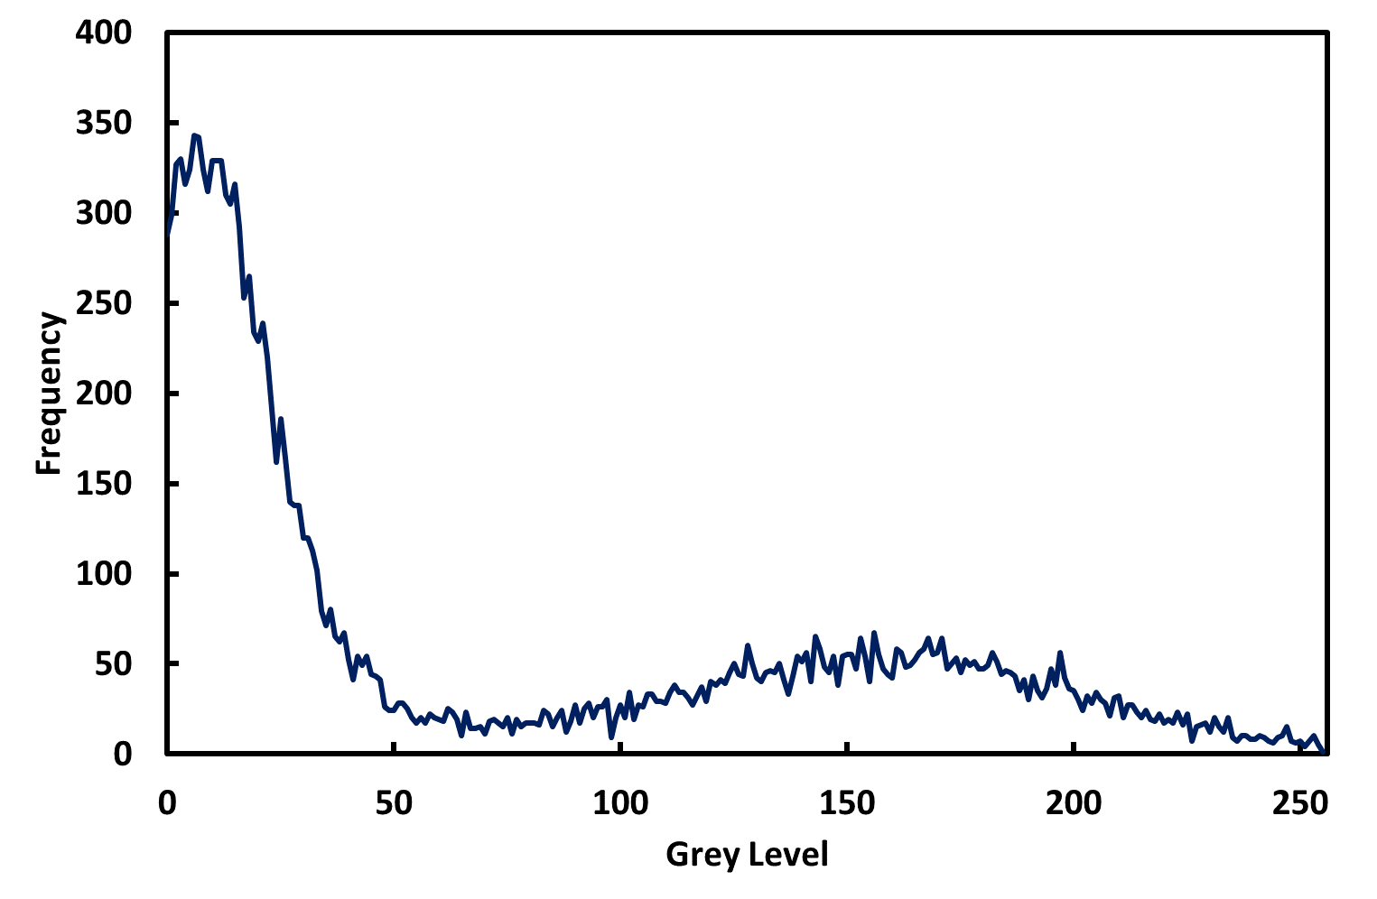
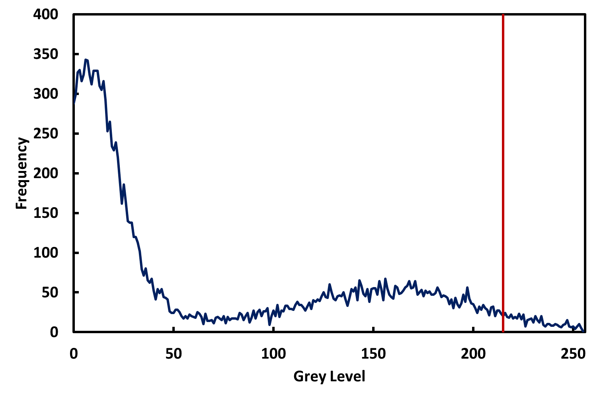
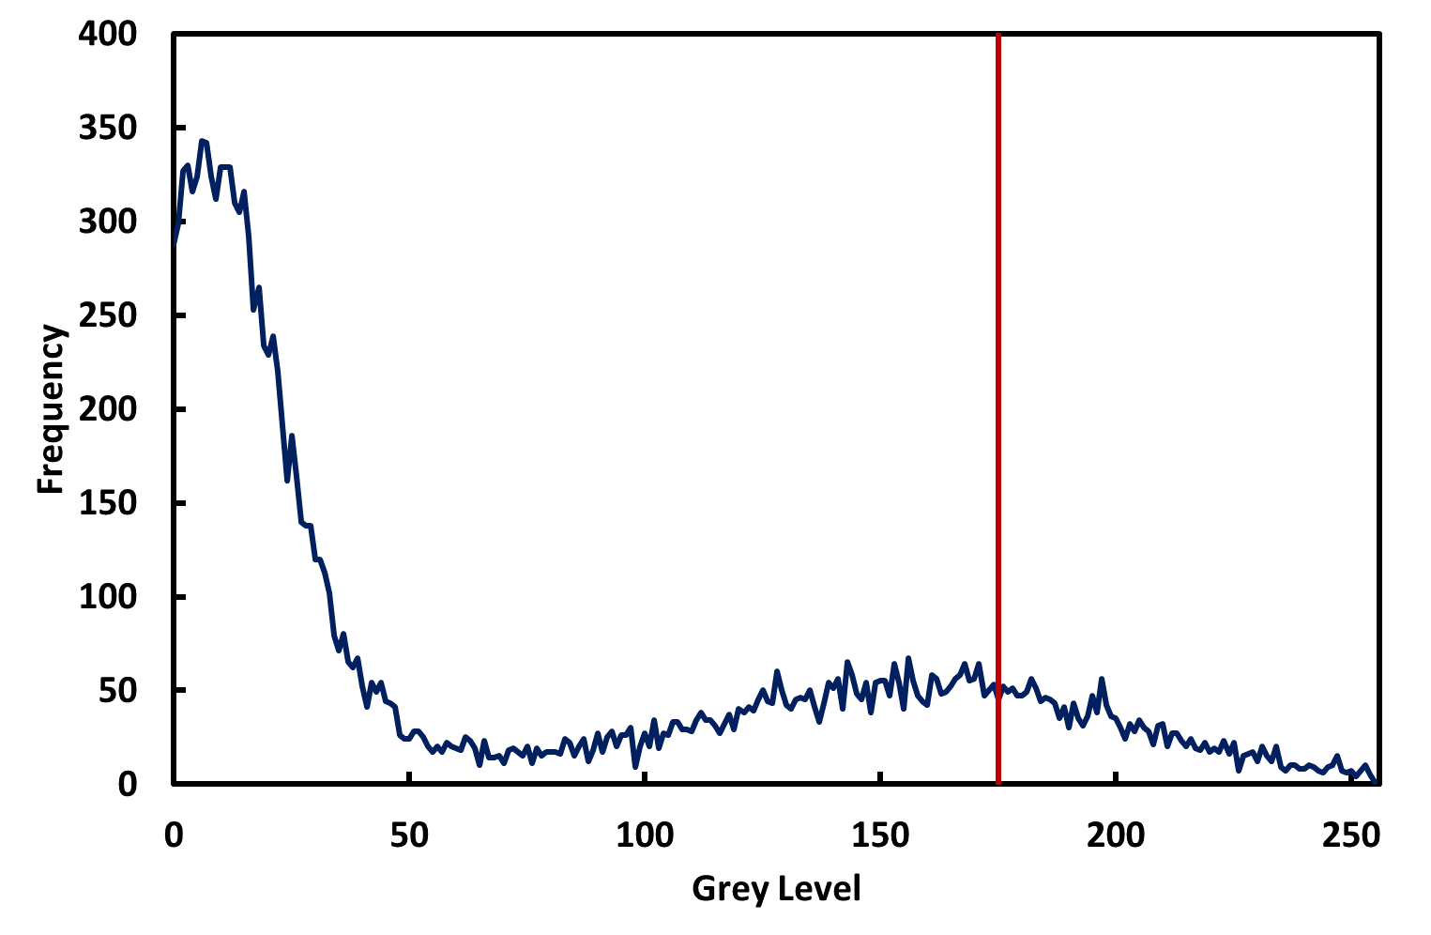
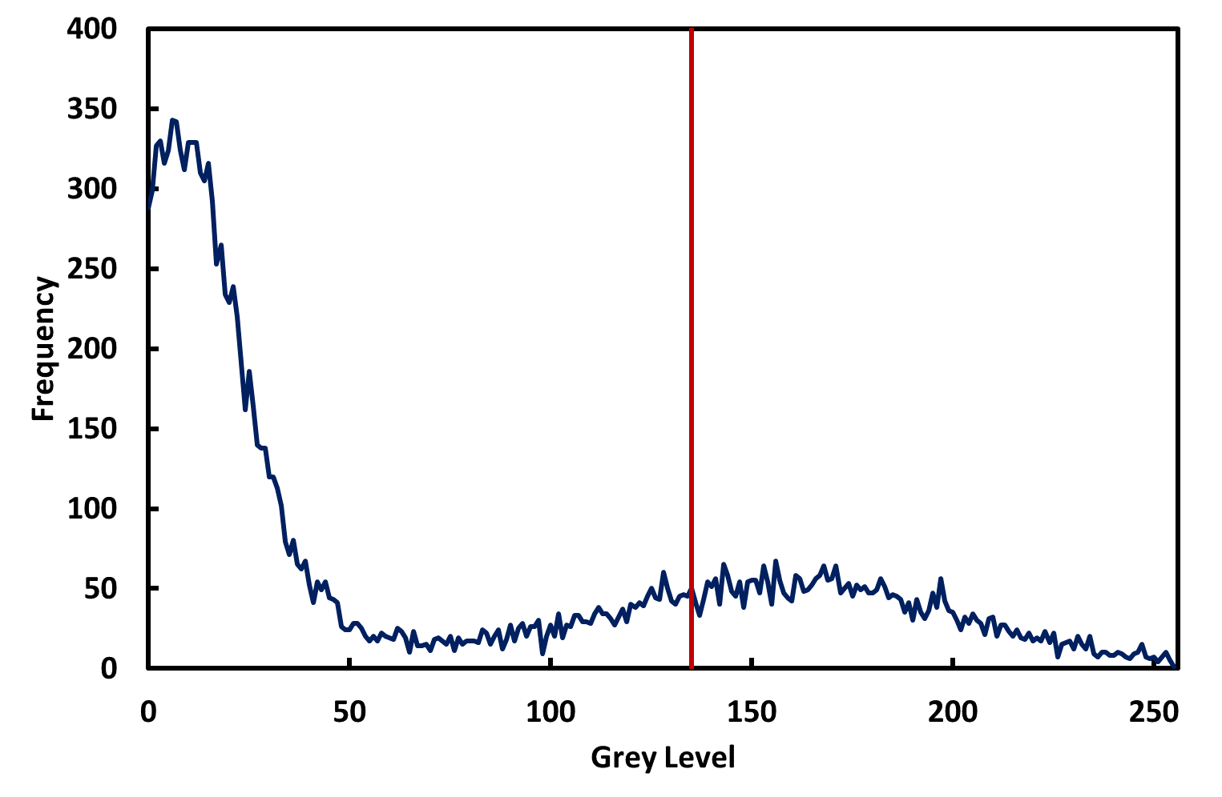
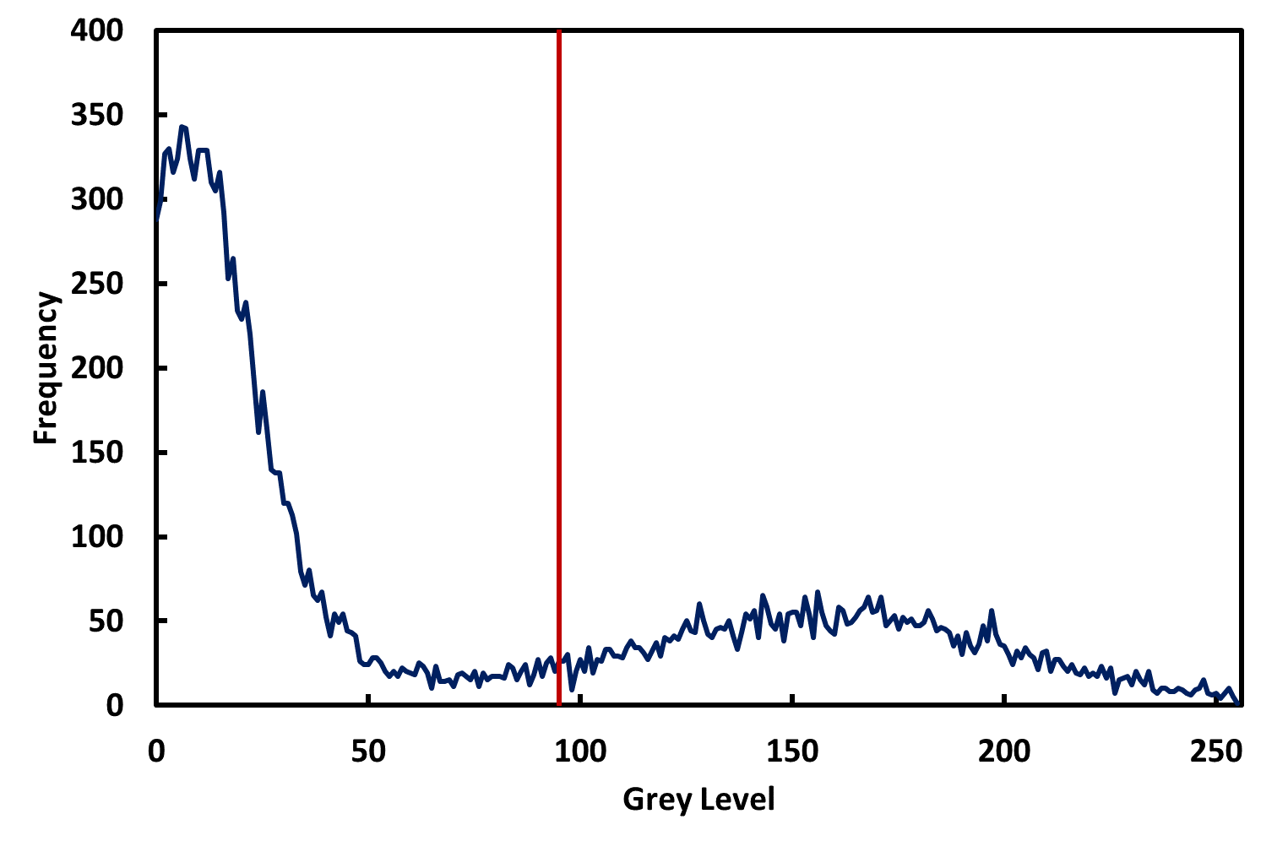



Background
255
Foreground
0
$$T> \frac{\text{Average} \text{of} \text{Foreground} \text{Pixels}+\text{Average} \text{of} \text{Background} \text{Pixels}}{2}$$
FIJI has several variations on this algorithm

Slide 25
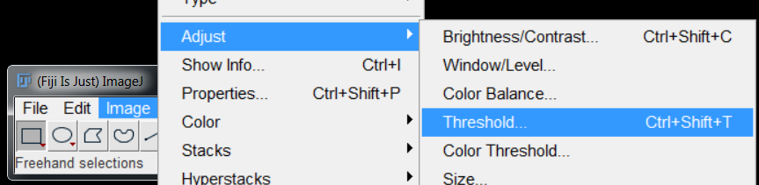
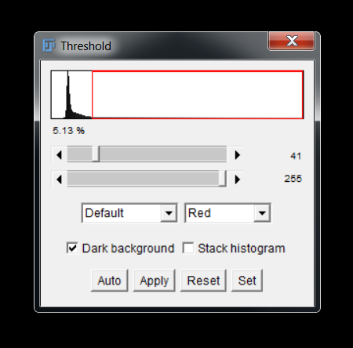
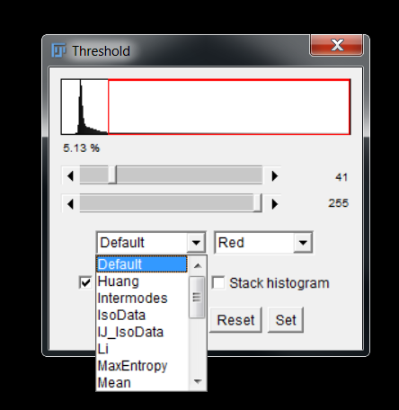
Click “Apply” to generate the binary image

Slide 26
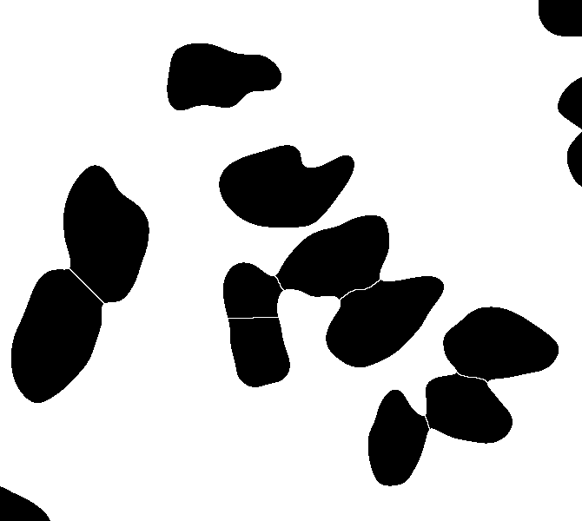
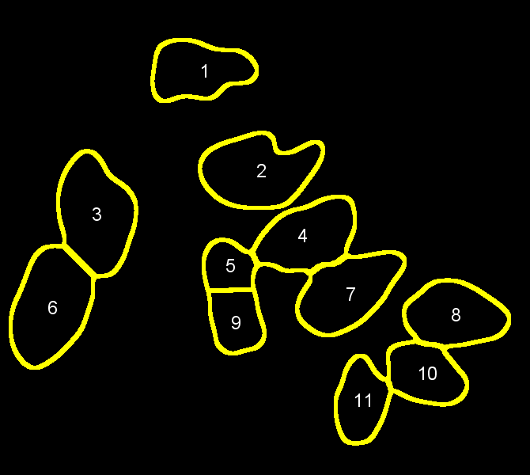
Masks and ROIS can be considered one and the same

Slide 27

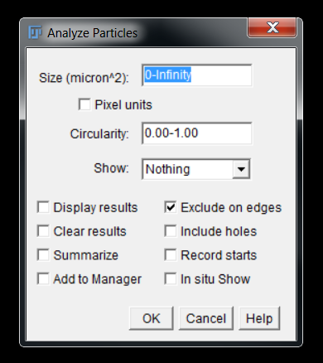
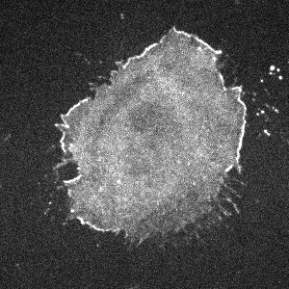
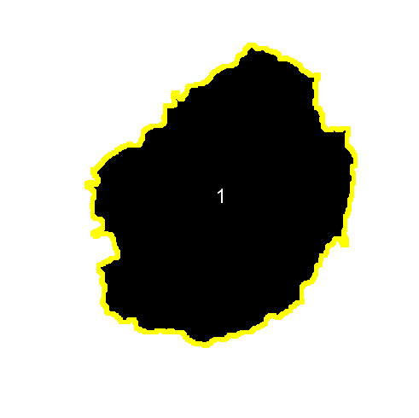
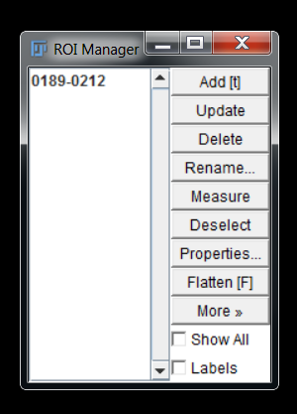
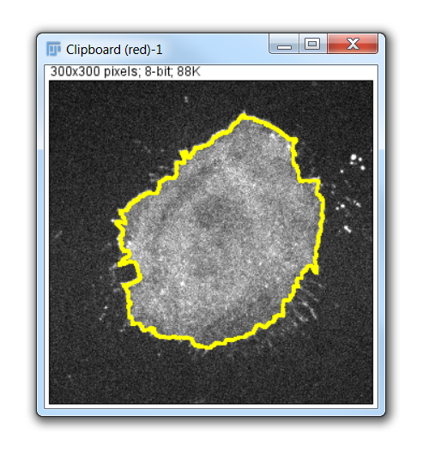

Slide 28
Costes’ Regression
T_{g} = 50
T_{g} = 90
T_{g} = 130
T_{g} = 180
T_{g} = 220
T_{r} = 200
P_{>T} = 0.90
P_{>T} = 0.80
P_{>T} = 0.70
P_{>T} = 0.60
T_{r} = 170
P_{>T} = 0.50
T_{r} = 128
P_{<T} = 0.60
P_{<T} = 0.45
P_{<T} = 0.30
P_{<T} = 0.15
P_{<T} = 0.00
T_{r} = 70
T_{r} = 50
Costes et al., Biophys J, 2004

Slide 29
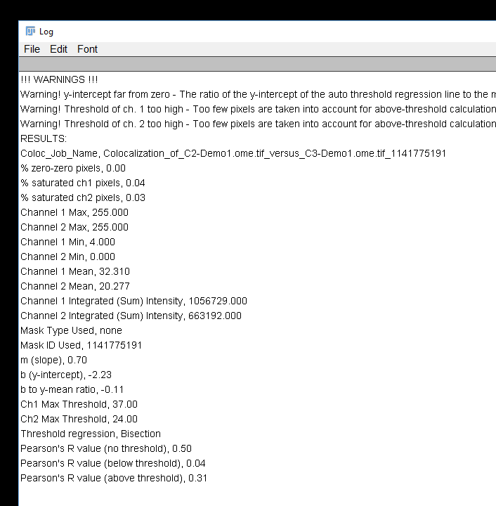
This should be close to zero

Slide 30
Demo 5: Setting Thresholds & Defining Regions

Slide 31
Quiz 6: Setting Thresholds & Defining Regions
Open the image in the Quiz 6 folder with Bio-Formats:
Use the DAPI channel to define an ROI and measure colocalisation in the other two channels
According to Pearson’s correlation coefficient, what is the extent of colocalisation between channels 2 and 3 within the nuclei?

Slide 32
Co-occurance Based approaches

Slide 33


Object-Based colocalisation
Detect objects in different channels and relate positions
Is signal nuclear or non-nuclear
Plot distributions from cell boundary

Slide 34




Object-based correlation coefficients
Detect objects:
Thresholding
Local maxima detection
Relate objects:
% Overlap
But with high resolution, probes may not overlap!
Nearest Neighbour
Mean Distance to Other objects
Cluster analysis

Slide 35




Slide 36






Slide 37


Slide 38






Relating different objects
Thresholded Dots
Find Maxima Dots
Nuclear Dots
Non-Nuclear Dots

Slide 39
Demo 6: Simple differentiation based on regions

Slide 40

A more refined approach relates distances…
Euclidean geometry – computationally intensive:
(x₁, y₁)
d
(x₂, y₂)
$$d= \sqrt{{\left(x_{2}−x_{1}\right)}^{2}+{(y_{2}−y_{1})}^{2}}$$
Counting pixels – limited resolution, but fast:
(x₁, y₁)
1
2
3
(x₂, y₂)

Slide 41
Distance Maps
1 | 1 | 1 | 1 | 1 | 1 | 1 | 1 | 1 | 1
1 | 0 | 1 | 0 | 0 | 1 | 1 | 1 | 0 | 1
1 | 1 | 0 | 0 | 0 | 1 | 0 | 0 | 0 | 1
1 | 0 | 0 | 0 | 0 | 0 | 0 | 0 | 0 | 1
1 | 0 | 0 | 0 | 0 | 0 | 0 | 0 | 0 | 1
1 | 1 | 0 | 0 | 0 | 0 | 0 | 0 | 1 | 1
1 | 0 | 0 | 0 | 0 | 0 | 0 | 0 | 1 | 1
1 | 0 | 0 | 0 | 0 | 0 | 0 | 0 | 1 | 1
1 | 0 | 1 | 1 | 1 | 0 | 0 | 0 | 1 | 1
1 | 1 | 1 | 1 | 1 | 1 | 1 | 1 | 1 | 1
0 | 0 | 0 | 0 | 0 | 0 | 0 | 0 | 0 | 0
0 | 1 | 0 | 1 | 1 | 0 | 0 | 0 | 1 | 0
0 | 0 | 1 | 1 | 1 | 0 | 1 | 1 | 1 | 0
0 | 1 | 1 | 2 | 1 | 1 | 1 | 2 | 1 | 0
0 | 1 | 1 | 2 | 2 | 2 | 2 | 1 | 1 | 0
0 | 0 | 1 | 2 | 3 | 3 | 2 | 1 | 0 | 0
0 | 1 | 1 | 2 | 2 | 2 | 2 | 1 | 0 | 0
0 | 1 | 1 | 1 | 1 | 1 | 2 | 1 | 0 | 0
0 | 1 | 0 | 0 | 0 | 1 | 1 | 1 | 0 | 0
0 | 0 | 0 | 0 | 0 | 0 | 0 | 0 | 0 | 0

Slide 42




Slide 43


Binary Mask
FIJI will always apply measurements to whatever image is specified here
Fluorescent Signal

Slide 44


Using maps to plot distances

Slide 45
Demo 7: Calculate relative nuclear expression

